Slide 1
Wildfires & Weather
Wild Fires caused by the weather

Slide 2
Background
Within the next two decades, temperatures will rise 1.5 degrees Celsius.
The last 7 years have been the warmest on record.
A warming world also increases the intensity of natural disasters, especially wildfires.
Humans cause 80% of the wildfires.
01

Slide 3
The research
Can it be predicted whether the future fire ended due to the weather or not?
02

Slide 4
Research process
Machine Learning
EDA
Data Cleaning
Data Acquisition
03

Slide 5
Data Acquisition
04

Slide 6


Data Acquisition
WildFires Data - Crawling
The website we used for the crawling is the National Interagency Fire Center.
The fire history on this website was provided by the infinite table.
We used Selenium to load the whole table and Firefox webdriver to save the entire HTML content.
With the HTML content, we used BeautifulSoup to read the table and save it to a CSV file.
05

Slide 7

Data Acquisition
WildFires Data - Weather API
The fire history does not include the weather data we needed for our research.
We used the 'Visual Crossing API' to get the required weather history.
06

Slide 8
Data Cleaning
07

Slide 9
Data Cleaning
Process
Columns cleaning
Missing data
Duplicates
Data formatting
Outliers
08

Slide 10
Data Cleaning
Data Formatting
Converting FireDiscoveryDateTime and FireOutDateTime to ISO format(yyyy-MM-ddTHH:mm:ss) for the weather API
Adding Fire Duration column
Convert Fire Cause to categoric column
Adding a new binary column: CausedByWeather (1 -> True, 0 -> False)
09

Slide 11
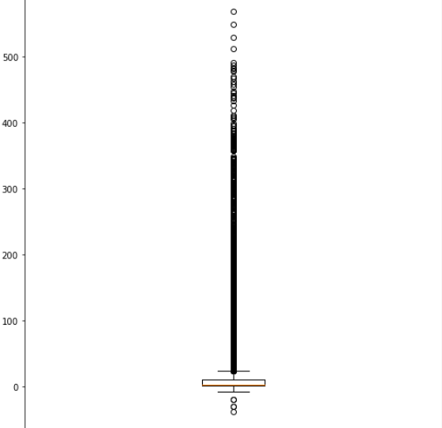
Data Cleaning
Outliers - Fire Duration
Creating a Fire Duration column by calculating the days between the end and the start fire dates.
Handling duration outliers such as negative duration, exceptional duration.
10

Slide 12
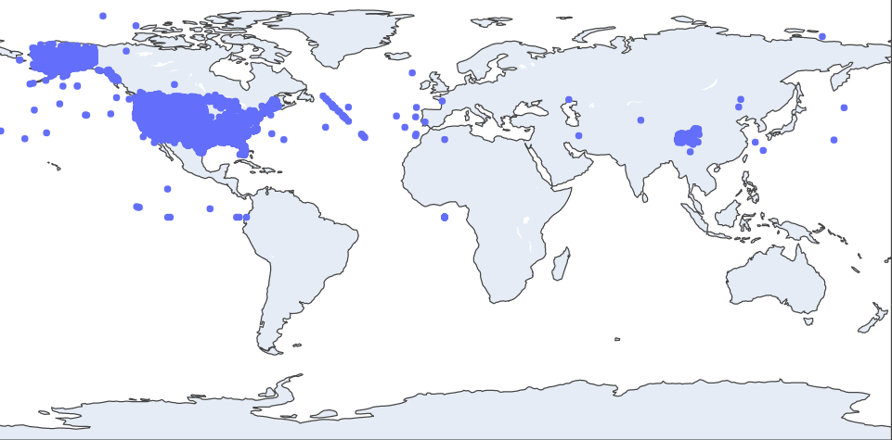
Data Cleaning
Outliers - Fire Location
The fire history we used is based on USA history. Using the geopy library, longitude, and latitude columns, we validated that our fires are within the USA's borders and removed those that aren't.
11

Slide 13
Exploratory Data Analysis
12

Slide 14
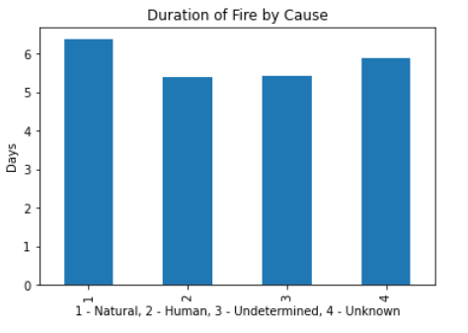
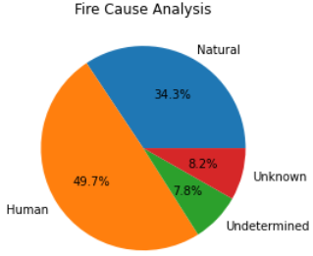
Exploratory Data Analysis
Fire Analysis
13

Slide 15
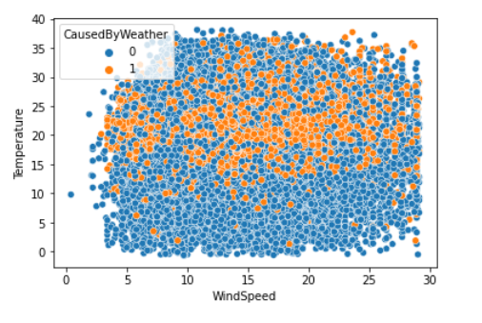
Exploratory Data Analysis
Temperature & Wind Speed
This graph represents the connection between the temperature and the wind speed.
The fires caused by nature are marked in orange, and others are marked in blue.
Conclusion: The higher the temperature & wind speed the more caused by weather fires
14

Slide 16
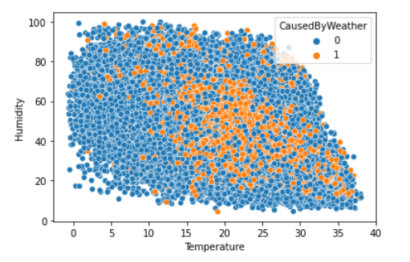
Exploratory Data Analysis
Temperature & Humidity
This graph represents the connection between the temperature and the humidity..
The fires caused by nature are marked in orange, and others are marked in blue.
Conclusion: The higher the temperature and lower humidity the more caused by weather fires
15

Slide 17
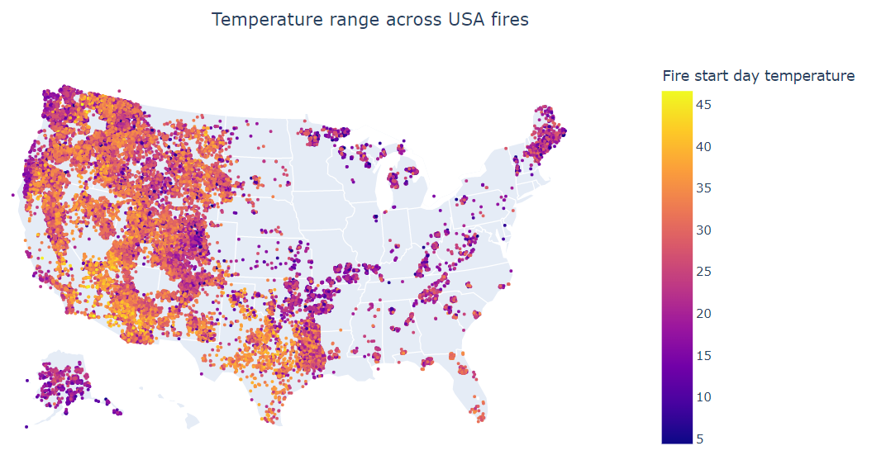
Exploratory Data Analysis
Temperature & Fire Location
This graph represents the temperature range across the fires.
The temperature we presented here is the maximum temperature that was that day.
Conclusion: We can see that there is an impact of the temperature on the fires.
16

Slide 18
Machine Learning
17

Slide 19
Machine Learning
The type of machine learning we will use is Supervised Learning.
The label type is Classification Problems.
The Algorithm we will use to predict our findings is KNN.
18

Slide 20
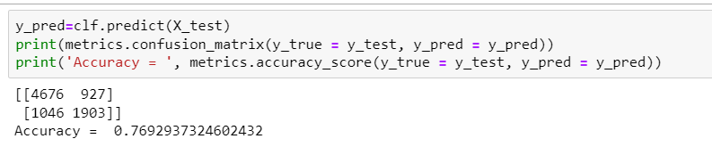
Machine Learning
KNN Algorithm
We used cross-validation in order to find the best K for our algorithm. The maximum K we used is less than the square root value of the X_train which is 184.
The best K we found is 15 and prediction percentages is 77%
19

Slide 21
Conclusion
We indeed see a deep connection between wildfires cause by nature and the weather.
From our prediction, we can see that by adding additional weather features, we will be able to increase our percentages.
20

Slide 22
Bibliography
earthday.org
National Interagency Fire Center
c2es.org
21

Slide 23
Thank you

